Slide 1
6.852: Distributed Algorithms Fall, 2015
Lecture 14, Part 1

Slide 2
Weak Logical Time and Vector Timestamps

Slide 3
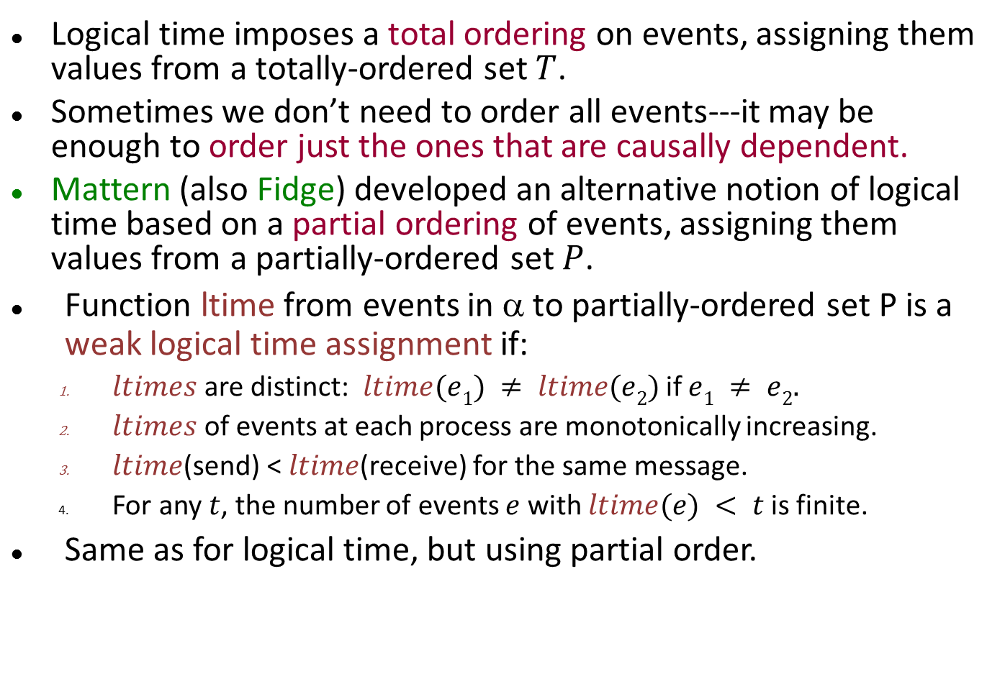
Weak Logical Time
Logical time imposes a total ordering on events, assigning them values from a totally-ordered set $T$.
Sometimes we don’t need to order all events---it may be enough to order just the ones that are causally dependent.
Mattern (also Fidge) developed an alternative notion of logical time based on a partial ordering of events, assigning them values from a partially-ordered set $P$.
Function ltime from events in α to partially-ordered set P is a weak logical time assignment if:
$ltimes$are distinct: $ltime(e1) ≠ ltime(e2)$if $e1 ≠ e2.$
$ltimes$ of events at each process are monotonically increasing.
$ltime$(send) < $ltime$(receive) for the same message.
For any $t$, the number of events $e$ with $ltime(e) < t$is finite.
Same as for logical time, but using partial order.

Slide 4
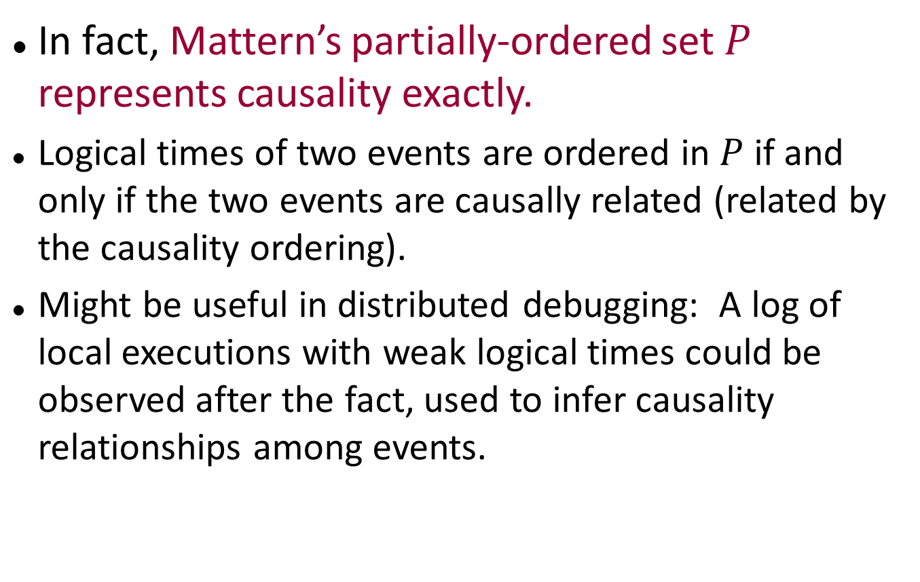
Weak Logical Time
In fact, Mattern’s partially-ordered set $P$ represents causality exactly.
Logical times of two events are ordered in $P$ if and only if the two events are causally related (related by the causality ordering).
Might be useful in distributed debugging: A log of local executions with weak logical times could be observed after the fact, used to infer causality relationships among events.

Slide 5
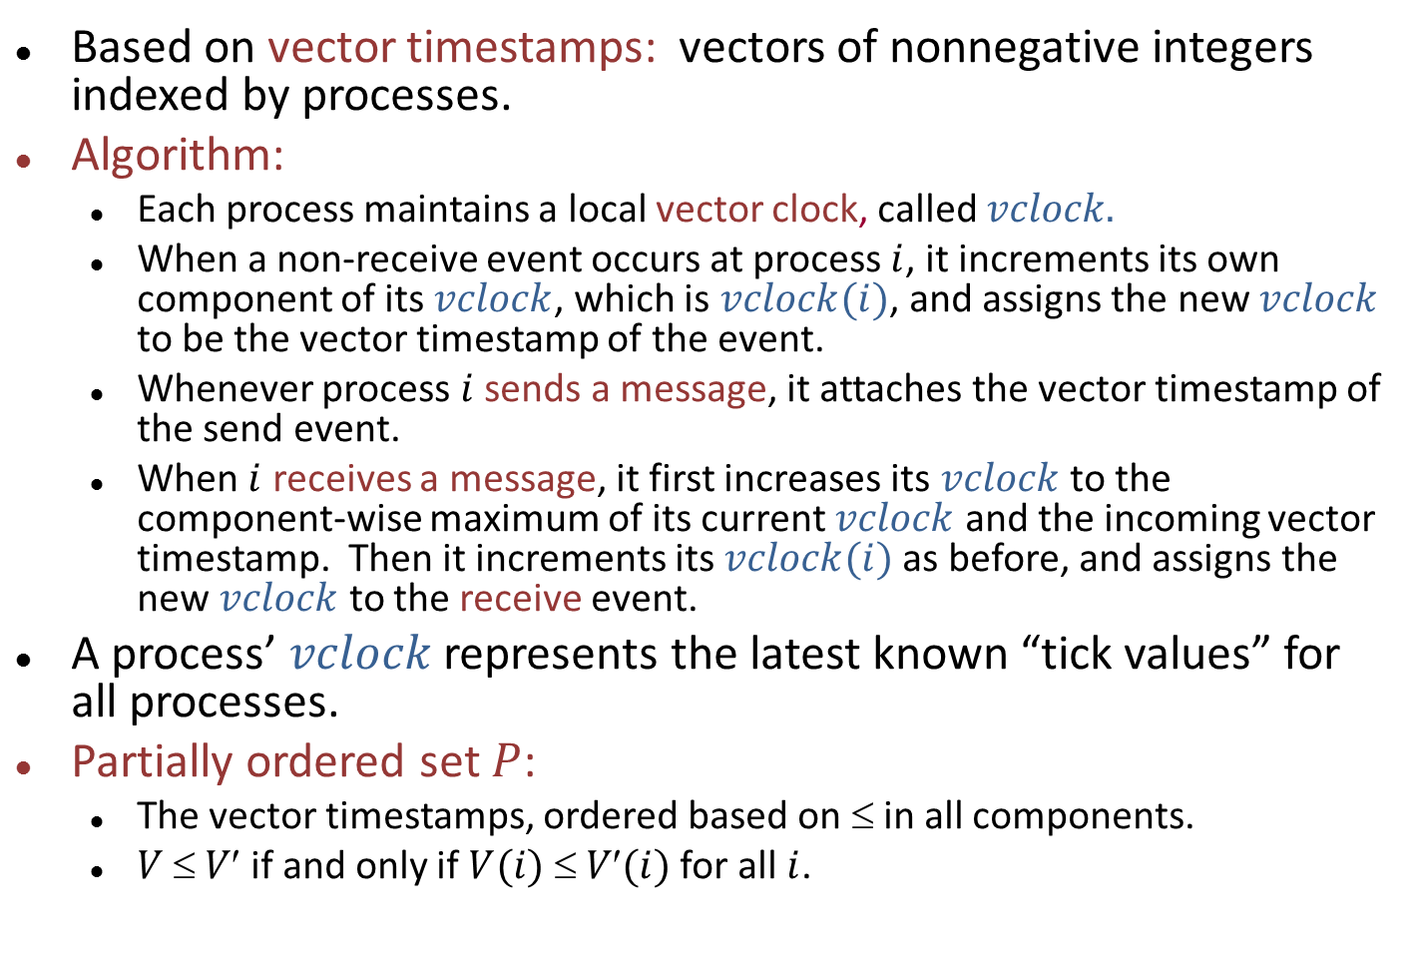
Algorithm for weak logical time
Based on vector timestamps: vectors of nonnegative integers indexed by processes.
Algorithm:
Each process maintains a local vector clock, called $vclock.$
When a non-receive event occurs at process $i$, it increments its own component of its $vclock$, which is $vclock(i)$, and assigns the new $vclock$ to be the vector timestamp of the event.
Whenever process $i$ sends a message, it attaches the vector timestamp of the send event.
When $i$ receives a message, it first increases its $vclock$ to the component-wise maximum of its current $vclock$ and the incoming vector timestamp. Then it increments its $vclock(i)$as before, and assigns the new $vclock$ to the receive event.
A process’ $vclock$ represents the latest known “tick values” for all processes.
Partially ordered set $P$:
The vector timestamps, ordered based on ≤ in all components.
$V  V$if and only if $V(i)  V(i)$for all $i$.
Notes:
This is an algorithm to implement weak log. time.

Slide 6
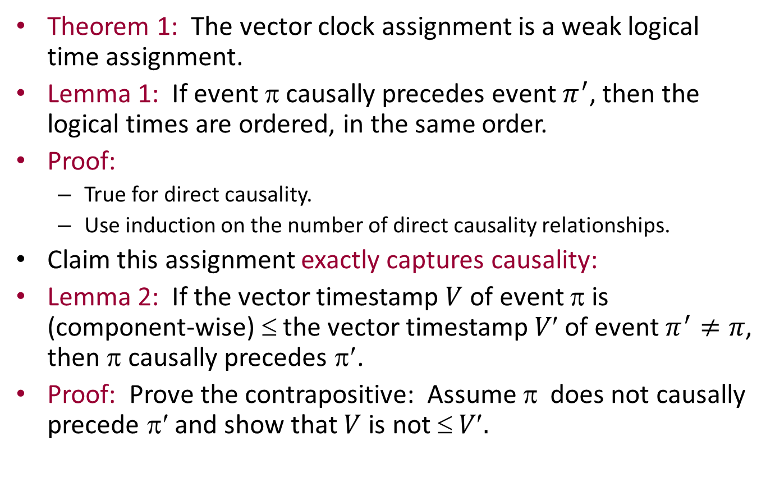
Key theorems about vector clocks
Theorem 1: The vector clock assignment is a weak logical time assignment.
Lemma 1: If event $$ causally precedes event $π^{′}$, then the logical times are ordered, in the same order.
Proof:
True for direct causality.
Use induction on the number of direct causality relationships.
Claim this assignment exactly captures causality:
Lemma 2: If the vector timestamp $V$ of event π is (component-wise) ≤ the vector timestamp $V$ of event $π^{′}≠π$, then π causally precedes π′.
Proof: Prove the contrapositive: Assume $$ does not causally precede π′ and show that $V$is not $ V.$

Slide 7
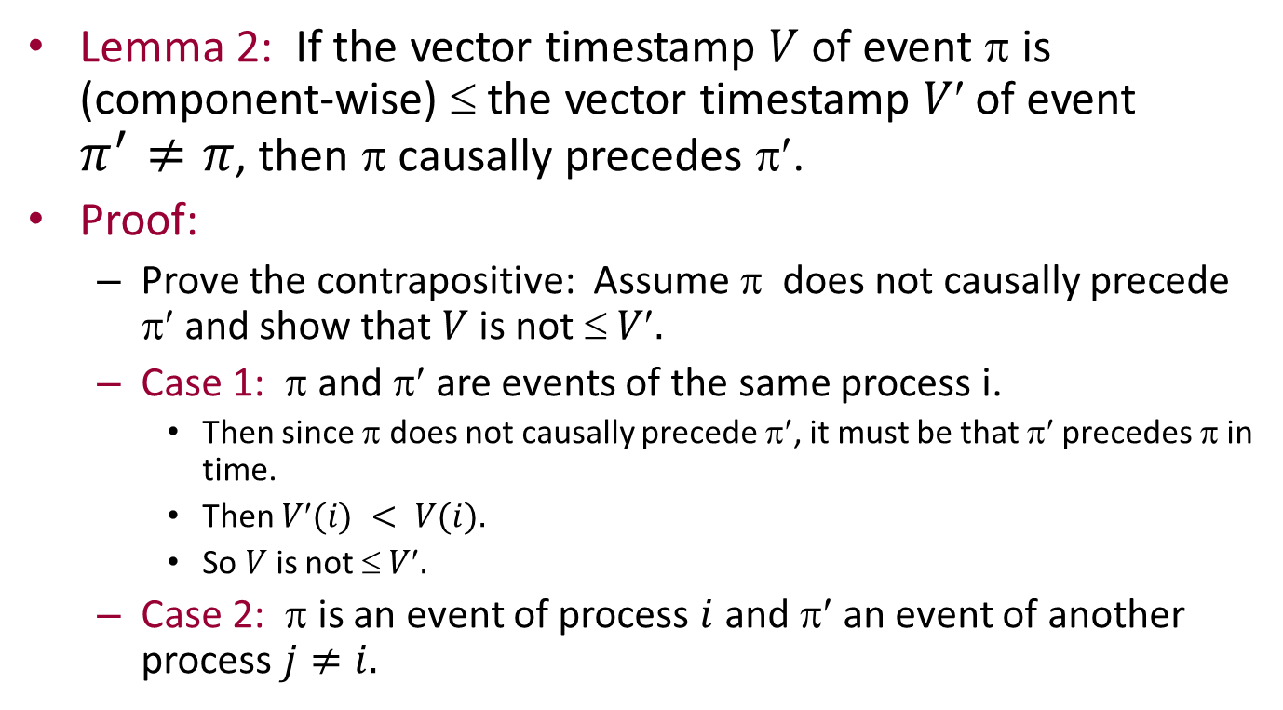
Proof of Lemma 2
Lemma 2: If the vector timestamp $V$of event π is (component-wise) ≤ the vector timestamp $V$ of event $π^{′}≠π$, then π causally precedes π′.
Proof:
Prove the contrapositive: Assume π does not causally precede π′ and show that $V$is not $ V.$
Case 1: π and π′ are events of the same process i.
Then since π does not causally precede π′, it must be that π′ precedes π in time.
Then $V(i) < V(i).$
So $V$is not $ V.$
Case 2: π is an event of process $i$ and π′ an event of another process $j≠i.$

Slide 8
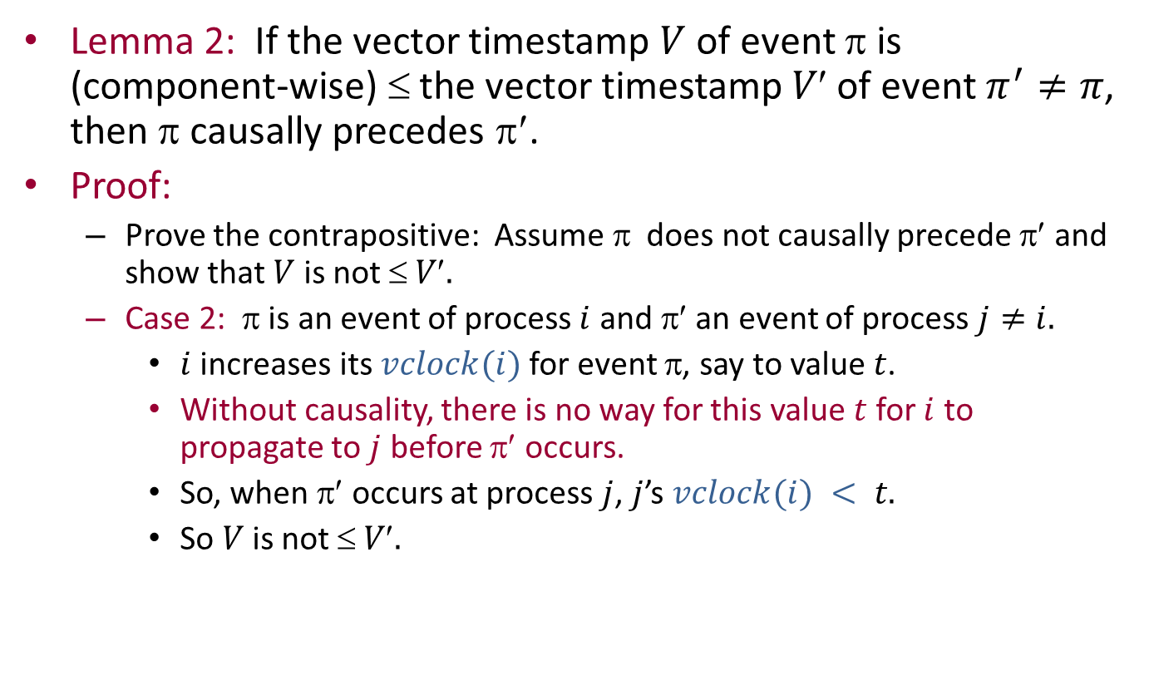
Proof of Lemma 2
Lemma 2: If the vector timestamp $V$ of event π is (component-wise) ≤ the vector timestamp $V$ of event $π^{′}≠π$, then π causally precedes π′.
Proof:
Prove the contrapositive: Assume π does not causally precede π′ and show that $V$ is not $ V.$
Case 2: π is an event of process $i$ and π′ an event of process $j≠i.$
$i$ increases its $vclock(i)$for event π, say to value $t$.
Without causality, there is no way for this value $t$ for $i$ to propagate to $j$ before π′ occurs.
So, when π′ occurs at process $j$, $j$’s $vclock(i) < t.$
So $V$ is not $ V.$

Slide 9
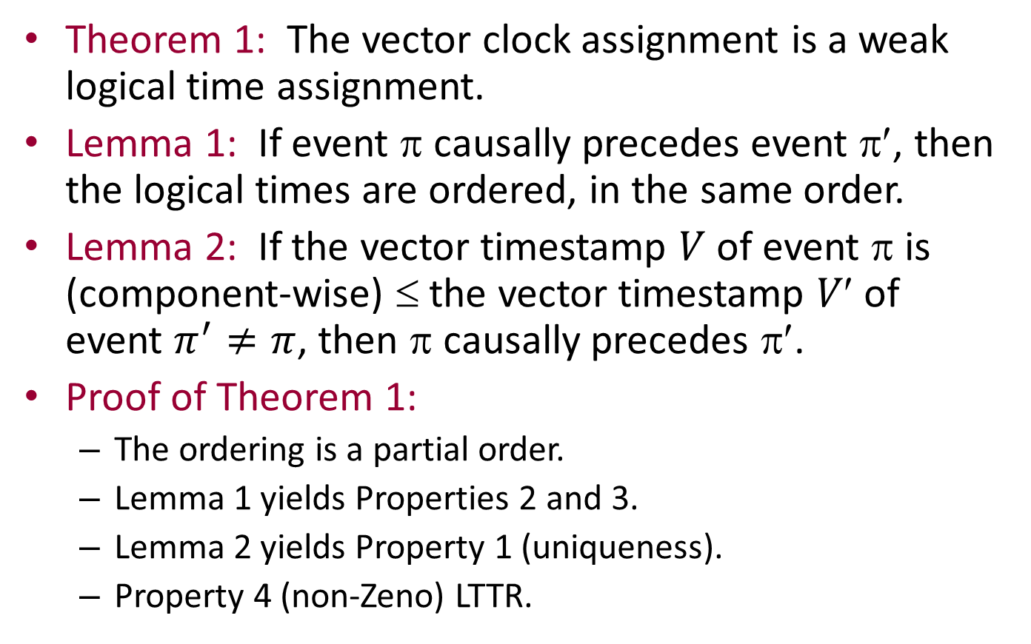
Back to Theorem 1
Theorem 1: The vector clock assignment is a weak logical time assignment.
Lemma 1: If event π causally precedes event π′, then the logical times are ordered, in the same order.
Lemma 2: If the vector timestamp $V$ of event π is (component-wise) ≤ the vector timestamp $V$ of event $π^{′}≠π$, then π causally precedes π′.
Proof of Theorem 1:
The ordering is a partial order.
Lemma 1 yields Properties 2 and 3.
Lemma 2 yields Property 1 (uniqueness).
Property 4 (non-Zeno) LTTR.
Notes:
For Property 1, suppose that two events have the same vector timestamp. Then each causally precedes the other, so they must be the same event.
Property 4 argument is like the one for Lamport time.

Slide 10
Another important theorem about vector timestamps [Mattern]
Relates timestamps to consistent cuts of the causality graph.
Cut: A point between events at each process.
Specify a cut by a vector giving the number of preceding steps at each location.
Consistent cut: “Closed under causality”: If event π causally precedes event π′ and π′ is before the cut, then so is π.
Example:
Consistent
cut
Not
consistent
Notes:
This inconsistent cut has a message whose receive precedes the cut but whose send follows the cut.

Slide 11
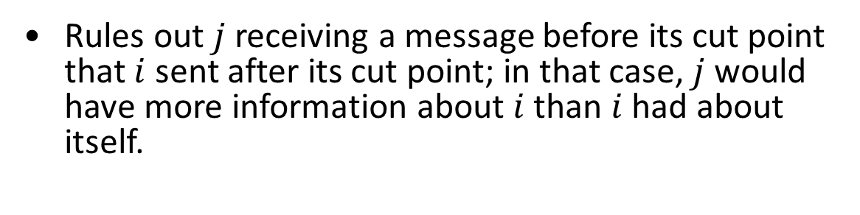
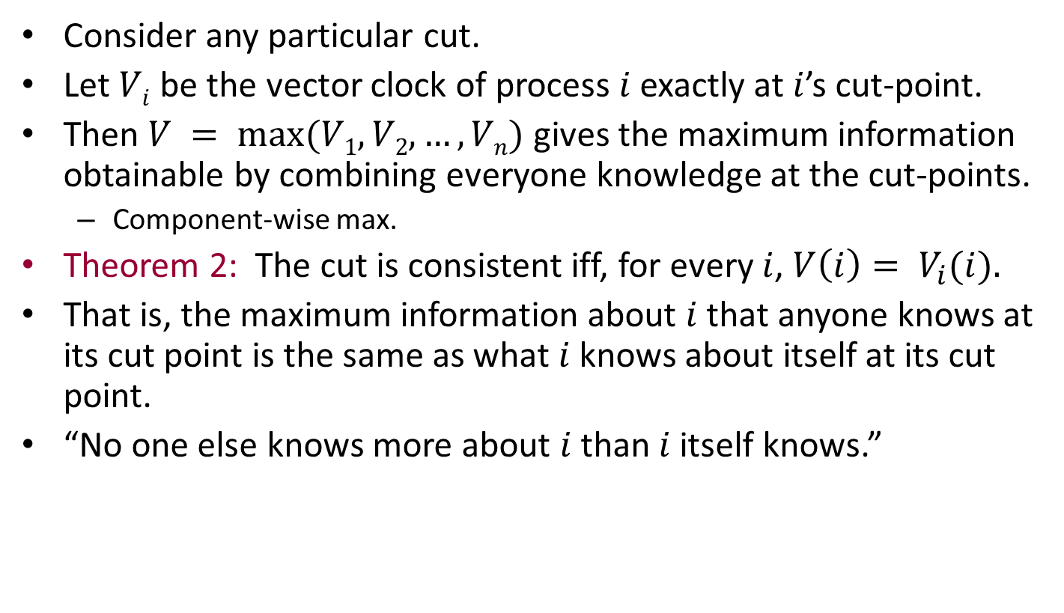
The theorem
Consider any particular cut.
Let $Vi$ be the vector clock of process $i$ exactly at $i$’s cut-point.
Then $V = max⁡(V1, V2,…,Vn)$gives the maximum information obtainable by combining everyone knowledge at the cut-points.
Component-wise max.
Theorem 2: The cut is consistent iff, for every $i$, $V\left(i\right)= V_{i}(i).$
That is, the maximum information about $i$ that anyone knows at its cut point is the same as what $i$ knows about itself at its cut point.
“No one else knows more about $i$ than $i$ itself knows.”
i
j
Rules out $j$ receiving a message before its cut point that $i$ sent after its cut point; in that case, $j$ would have more information about $i$than $i$ had about itself.

Slide 12
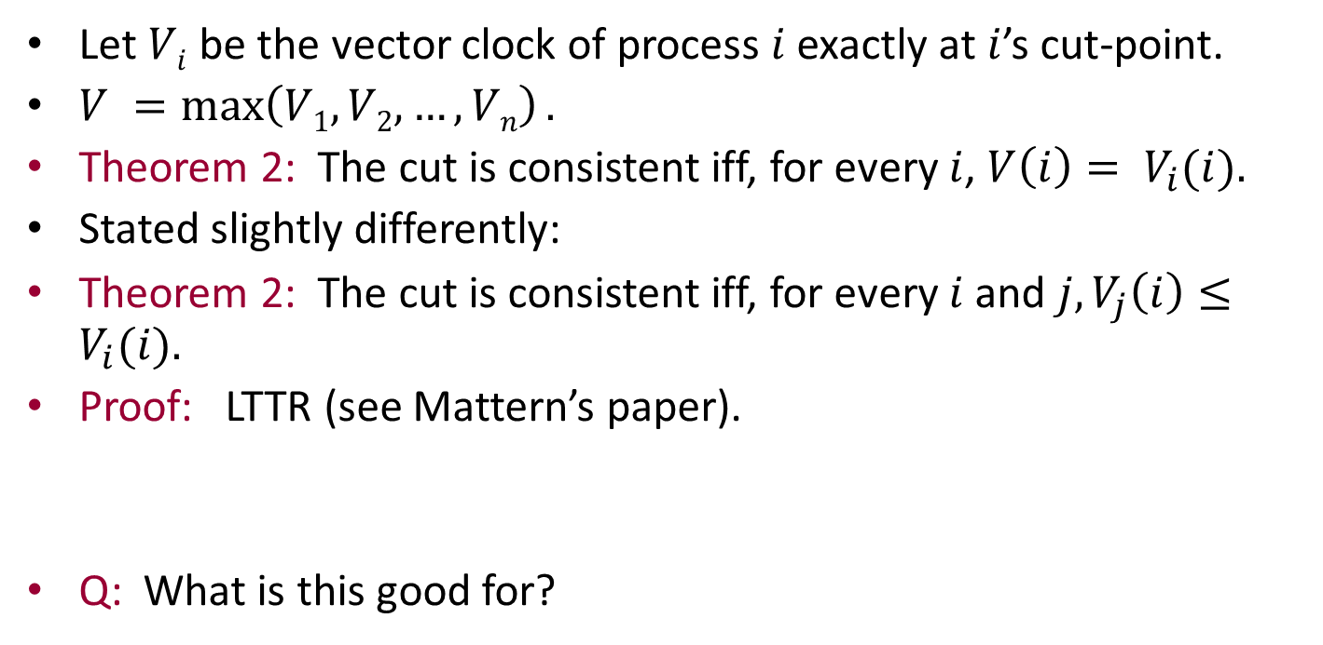
The theorem
Let $Vi$ be the vector clock of process $i$ exactly at $i$’s cut-point.
$V =\max\left(V1, V2,…,Vn\right).$
Theorem 2: The cut is consistent iff, for every $i$, $V\left(i\right)= V_{i}(i).$
Stated slightly differently:
Theorem 2: The cut is consistent iff, for every $i$and $j, V_{j}\left(i\right)≤V_{i}(i).$
Proof: LTTR (see Mattern’s paper).
Q: What is this good for?

Slide 13
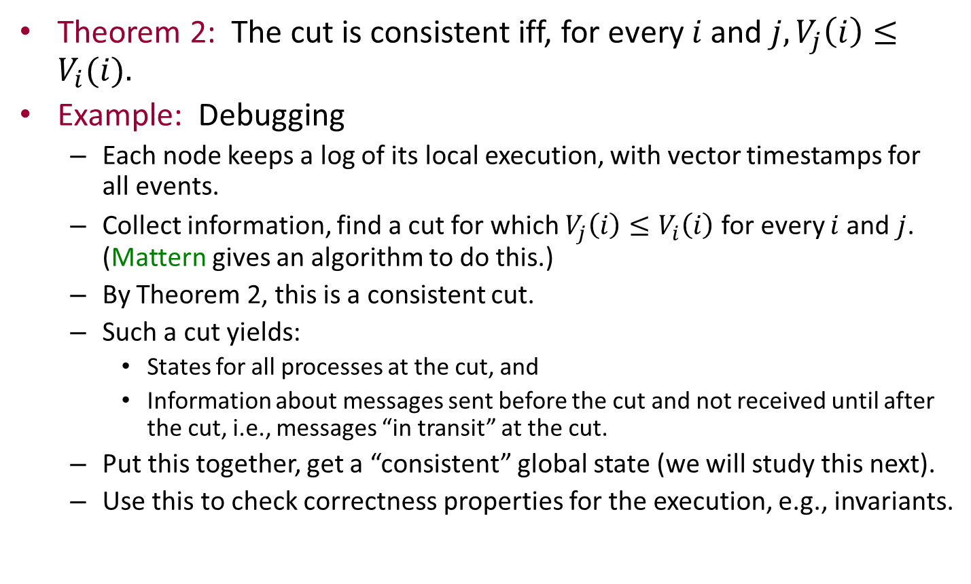
Application: Debugging
Theorem 2: The cut is consistent iff, for every $i$and $j, V_{j}\left(i\right)≤V_{i}(i).$
Example: Debugging
Each node keeps a log of its local execution, with vector timestamps for all events.
Collect information, find a cut for which $V_{j}\left(i\right)≤V_{i}\left(i\right)$for every $i$and $j$. (Mattern gives an algorithm to do this.)
By Theorem 2, this is a consistent cut.
Such a cut yields:
States for all processes at the cut, and
Information about messages sent before the cut and not received until after the cut, i.e., messages “in transit” at the cut.
Put this together, get a “consistent” global state (we will study this next).
Use this to check correctness properties for the execution, e.g., invariants.

